Slide 1

Airplane crashes
An analysis from 1900-2020
Divya
Bimal
Kelly
Lily
Warren

Slide 2

The project kicked-off with an intention to analyze the available data of airline crashes from 1908 till 2019.
Kaggle for data set- 4000+ records
ICAO website for further reading and analysis.
Objective:- Exploratory data analysis for plane crashes between 1908 and 2019 investigating on underlying reasons, location of events and finding trends if any.
Hypothesis:-
Is there any link between the different time periods and the fatality rate?
What has been the overall trend for air travel fatalities by country?
What are the most dangerous aircraft operators?
Which Aircraft types were most represented in accidents?
Which countries had the most accidents?
Visualization techniques:-
Python Flask-powered API Endpoints created with server-side rendering.
HTML , Plot.ly ,Geopy ,Apex.js and D3 used in combination for creating visuals including graphs and charts.
To start with….
Notes:
Warren

Slide 3
Extraction
Data was extracted from a Kaggle csv and contained data from 1908 to 2020.
Transforming The following cleaning was done using Jupyter notebooks:
Dropping columns for readability.
Formatting of dates using timestamp
Calculation and addition of a fatality rate column
Binning by 20-year periods with a corresponding column for sorting.
String splitting to extract origin airports for origin column.
Processing using GeoPY for geolocation data of countries.
Dropping of null values as well as fixing location data, as some entries were null due to crashes in international waters.
Loading
The data was loaded into Postgres using SQL alchemy
API Endpoints were created using flask.
Fun and Games
Notes:
Warren

Slide 4
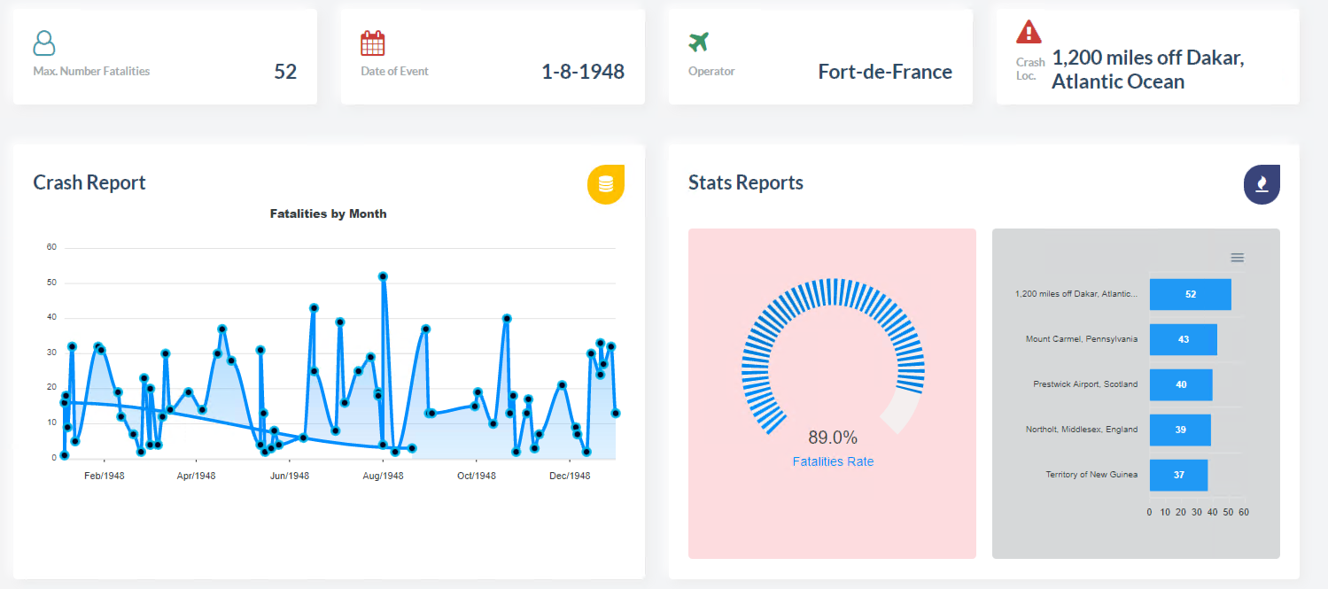
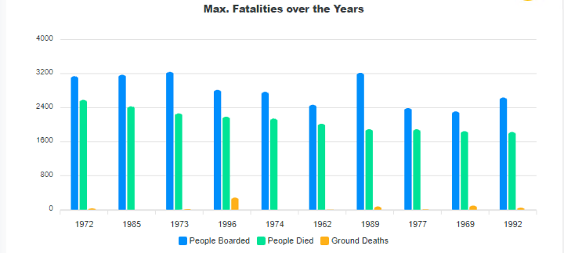
Time period Vs Crashes
Crashes reported has increased after the period of 1940.
Notably between 1970-1990
Highest fatality reported in 1948
Total crashes -77
Total fatalities -1264

Slide 5
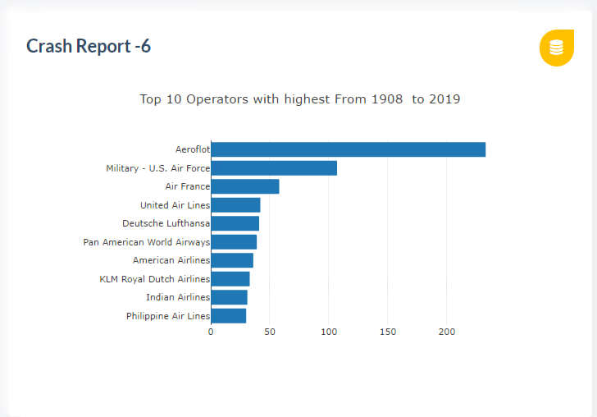
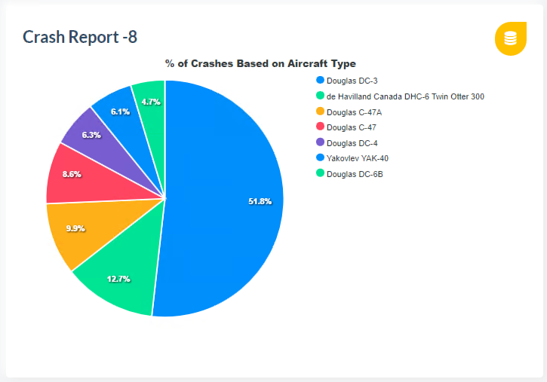
Operators to blame???...
Aeroflot?
Douglas !

Slide 6
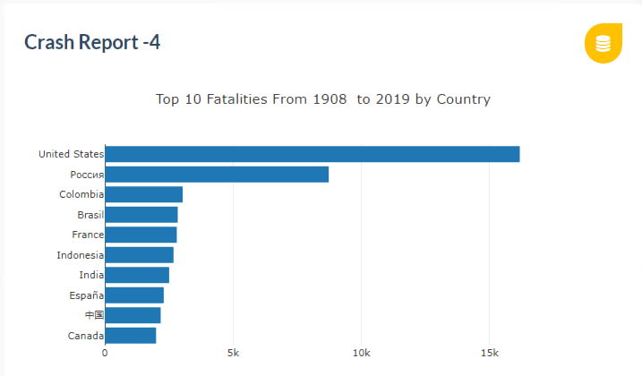
Crash landing countries……
53 sites were in sea/strait or ocean- Geopy returned no country names!
Highest recorded fatalities in USA- New York, Alaska, Chicago-Illinois, Burbank-California
2nd highest crash site is Russia(Moscow); followed by Colombia(Bogota, Medelin)
Top Reasons – bad weather conditions, mechanical failure and Pilot error.

Slide 7
Circular Packing & Word Cloud
Circular Packing Visualisation
Why did we choose this visualization?
We wanted to display the total number of fatalities per operator in a simple and concise manner. The use of colour and size makes the graph visually appealing and provides a different perspective on the data.
How did we do it?
We created an app route in app.py, filtered the data by fatalities greater than 200 and formatted the circles colour and size accordingly. We then created a tooltip and functions to enable the circles to be dragged.
What did we learn?
To re-adjust our expectations of what is achievable within a small timeframe.
Word Cloud Visualisation
Why did we choose this visualization?
To be able to spot the ‘origins’ (cities or airports) that planes that crashed took off from. The bigger the font of the word, the more planes crashes that took off from that location. It was also to provide a different, non-numerical graph. Of course there are limitations such as the named data (e.g. training) and level of detail font size can give.
How did we do it?
Created an app route in app.py using groupby functions to pull out ‘origins’ and count them. Then used the html and JavaScript code available on the D3 site to adapt it to use our own data.
What did we learn?
There does not appear to be a particularly dangerous continent to take off from. The cities that pop up are from all around the world. Next time, it would be worth filtering the top 20 to avoid so many illegible words.

Slide 8
Conclusions
1. An Increase in the number of fatalities recorded after 1945 observed. This could be the increased no. of flights and high mobility after WW2.
2. The countries with high frequency of flights and busier routes like US; rough terrain and weather conditions(Russia) and poor flight safety standards or regulatory regime(Colombia) had largest fatalities reported.
3. Operators - Aeroflot and Air France came out as the notorious ones for causing maximum fatalities in the crashes. Further investigations required to ascertain the reasons for the above.
4. Aircraft types caused most fatalities- Douglas Dc-3; followed by De Havilland Canada
5. The following years are noted for the largest no. of fatalities reported:-
1972 – 5166 fatalities; 62 incidents
Avg fatality rate per incident = 83.32%
1985 – 4860 fatalities
1996 – 4376 fatalities
2000 – 2786 fatalities; 57 incidents
Avg fatality rate per incident = 48.87%
2014 - 2248 fatalities

Slide 9
The data set was vast and had a lot of variables for analysis.
Data cleansing had to be improvised twice as we found some errors while progressing with the visualizations.
The visualization seemed more complex than we initially thought.
Further investigation is needed in order to explore the causes of the crashes- the summary column(which was dropped in the final version) was too vague to pick the keywords and lead to any conclusions.
Be realistic with your expectations..(Power BI rocks!!)
Lessons & hurdles…

Slide 10
Hudson river landing made by Captain Chesley Sullenberger of Airbus A320 in January 2009…
Qantas Airbus A380 grounded safely in Singapore airport after experiencing an engine explosion shortly after take-off(4th November 2010)..
“3 International Flights Escape Mid-air Collision Over Delhi, Pilots Summoned”
The three foreign airlines - Dutch carrier KLM, Taiwan's Eva Air, and US-based National Airlines - were flying at almost the same level which is a clear violation of mandatory separation. – 29 December 2018
Trivia time
It is common for an airline to cease using the flight number of a fatal crash, although that is not always the case.
Some good news….

